Slide 1

Code Portfolio
A.Rohini Reddy
21wu0101047
Team3

Slide 2


Welcome to Cerebratech
Empowering minds and data driven solution
The program focuses on key areas, including: Python Programming: Building strong coding skills. Database Management: Proficiency in MySQL and MongoDB. Data Analysis & Manipulation: Using Pandas and NumPy for effective data handling. Machine Learning: Applying algorithms for practical applications. Deep Learning: Exploring advanced techniques and neural networks. Web Development: Creating dynamic applications with Flask. Deployment (CI/CD): Implementing continuous integration and deployment practices.
"We’re thrilled to have you onboard as part of our growing community. Together, let’s innovate, learn, and build solutions for tomorrow!"

Slide 3
DAY1
-Introduce ourselves to our Trainer
-We were appointed as cerebra tech employees
-Rules of the company
-Python Programming -Contains scripts demonstrating Python programming skills, such as algorithms, automation, and small projects.
Python Basics:
Introduction: High-level, interpreted language, created by Guido van Rossum in 1991. Used in data science, machine learning, and web development.
Identifiers: Names for variables, functions, or classes.
Variables: Dynamically typed, types can change during runtime.
Data Types: Integers, floats, strings, and booleans.
Data Structures:
Lists: Ordered, mutable.
Tuples: Ordered, immutable.
Dictionaries: Key-value pairs.
Sets: Unordered, unique elements

Slide 4
Access Modifiers:
Public (default), Protected (_), Private (__).
OOP Concepts:
Classes & Objects: Classes define structures, objects are instances.
Inheritance: Child class inherits from parent class (single, multiple, etc.).
Polymorphism: Objects treated as parent class instances.
Encapsulation: Restricts access to internal state.
Abstraction: Hides internal details, shows essential functions.
Attributes:
Class Attributes: Shared by all instances.
Instance Attributes: Unique to each instance.
Methods:
Instance: Operates on instance data.
Class: Operates on class data.
Static: No interaction with class/instance data.
Exception Handling: Uses try, except, else, and finally blocks.
Our Mission and Vision
Repository link- https://github.com/rohini-reddy08/python-programming

Slide 5







DAY2
SQL (Structured Query Language) is used to interact with relational databases. Below is a comprehensive guide to SQL queries covering database creation, table manipulation, and advanced operations.
1. Database Creation
2. Table Manipulation
3. Basic SQL Operations
4. Advanced Queries
5. Constraints and Indexes
6. Transactions
7. Stored Procedures
8. Triggers
-50 SQL Challenges were given to code and submit using Github
-SQL queries to interact with relational databases.
-Includes database creation, table manipulation, and advanced queries.
-The SQL pdf documentation contains 25 questions along with their code and solutions.
Repository link- https://github.com/rohini-reddy08/SQL-CHALLENGE-

Slide 6

DAY3
Overview of Pandas and Numpy Python libraries
Pandas & NumPy:
Pandas: Data manipulation (cleaning, grouping, stats).
NumPy: Numerical computation (arrays, linear algebra).
EDA:
Steps: Clean data, analyze stats, visualize (Matplotlib, Seaborn, Plotly).
Visualization:
Matplotlib: Basic plots.
Seaborn: Aesthetic visuals.
Plotly: Interactive plots.
Machine Learning:
Supervised: Linear regression, classification.
Unsupervised: Clustering.
Reinforcement: Learning through rewards.
Discussed about exploratory data analysis and applied it to an existing dataset
Insights into datasets using Python visualization libraries.
-Steps include data cleaning, exploratory analysis, and visualization.
-Also discussed about machine learning algorithms including supervised (Linear regression and classification), unsupervised and reinforcement learning
Repository link- https://github.com/rohini-reddy08/pandas-assignment
https://github.com/rohini-reddy08/EDA-assignment-
ML Project: https://github.com/rohini-reddy08/ML-project
Dataset Project:

Slide 7
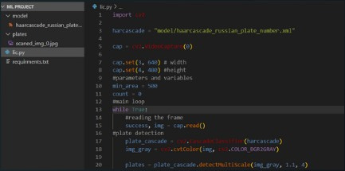

license plate Detection
To automate the detection of vehicle license plates in real-time using computer vision techniques.
Key Features:
Detects and highlights license plates in video streams or images.
Utilizes Haar Cascade Classifier for plate recognition.
Real-time processing with OpenCV.
Tools & Technologies:
OpenCV, Python, Haar Cascade XML for plate detection
Applications:
Traffic monitoring and law enforcement
Automated toll collection systems
Parking management systems
Workflow:
Capture video feed or image.
Convert to grayscale for preprocessing.
Apply Haar Cascade to detect plates.
Display or save the extracted plate region.
Output:
Real-time detection and bounding box visualization of license plates.

Slide 8
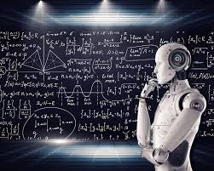
Artificial Neural Network (ANN):
An ANN is a model inspired by the human brain, with an input layer, hidden layers for pattern extraction, and an output layer for predictions. It uses activation functions (e.g., ReLU, Sigmoid) to learn complex patterns.
Deep Learning:
A subset of machine learning using ANNs with multiple hidden layers for hierarchical learning. It is effective for tasks like image recognition, NLP, and speech recognition, processing large datasets.
DAY4
-Artifical Neural Network(ANN)
-Deep Learning
Repository link-https://github.com/rohini-reddy08/DL-assignmenet

Slide 9

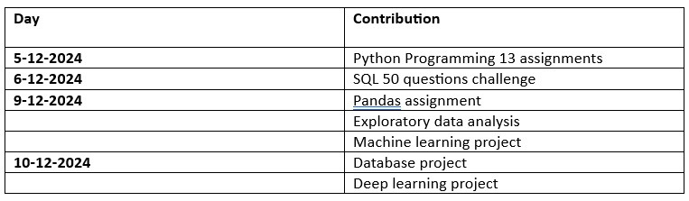
Github contributuions

Slide 10
Thank you

